Slide 1
The Value of Coordinated Observations: Hurricane Gliders
Scott Glenn (Rutgers University) plus many others,
including NOAA, IOOS, Navy, NSF, States,
Universities, Companies, Foundations,
OceanOPS, NPOMS, OceanGliders, IMOS, EGO….

Slide 2
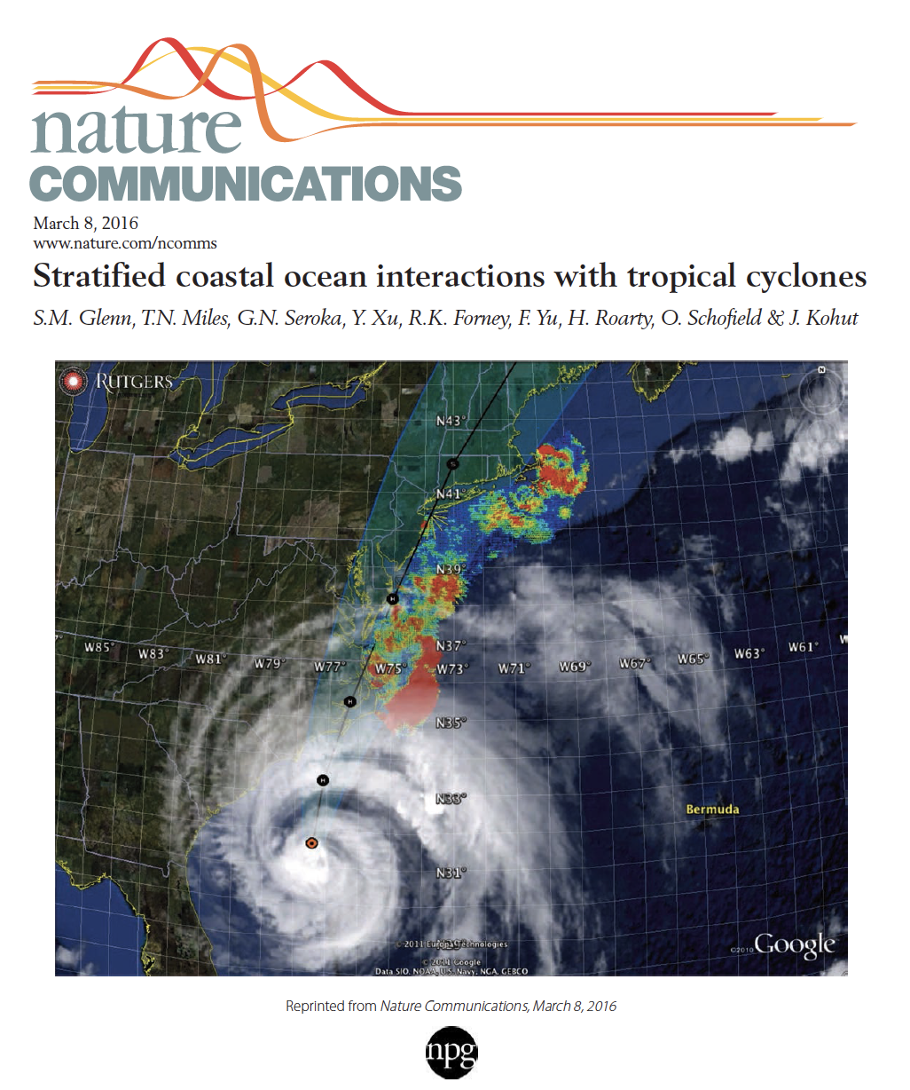
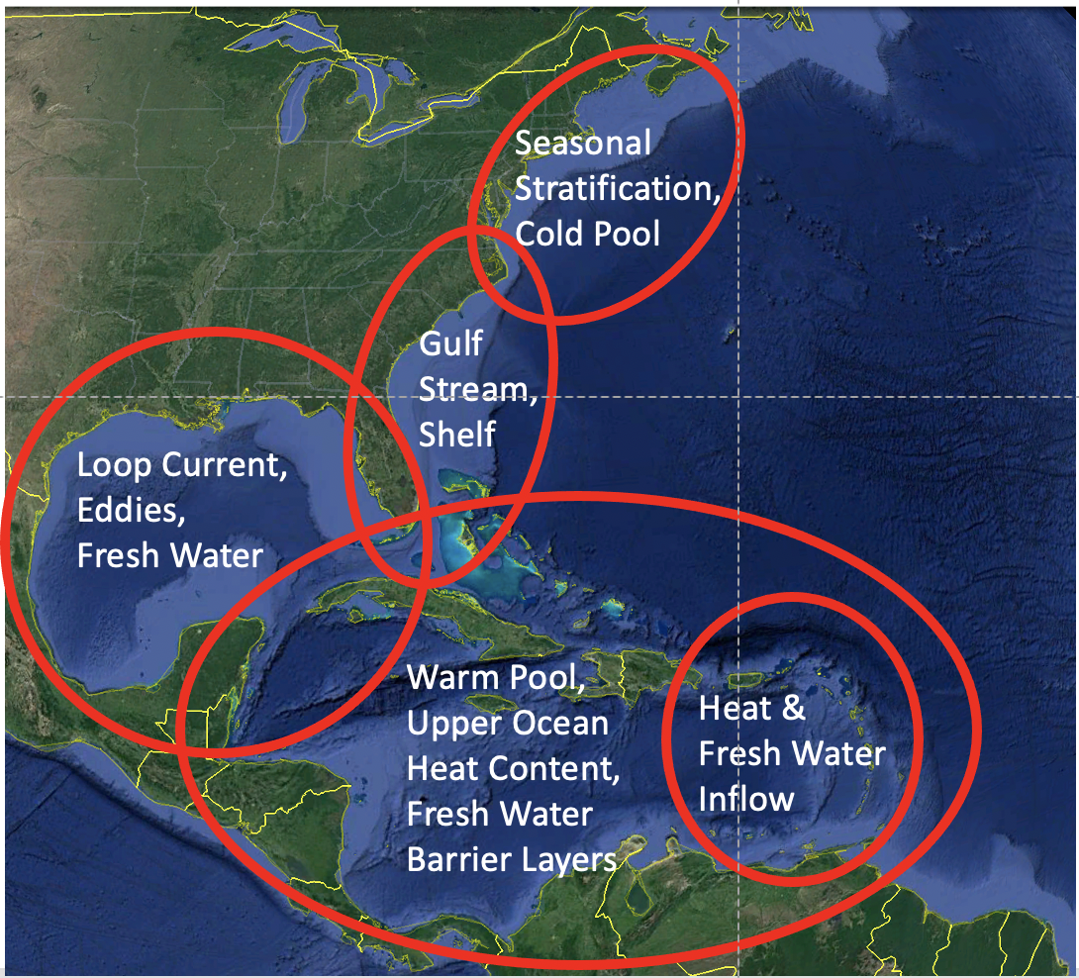
Hurricane Glider - Background
Sandy Supplemental (2014-2016) was Transformational:
Layered OAR science with IOOS operations to benefit NWS
Tested multiple new technologies, including Hurricane Gliders
Engaged early career scientists – who are still with us!
New science on rapid co-evolution of ocean-atmosphere further motivates ocean model improvements for forecasting rapid intensity change
(intensification and weakening)
Essential Ocean Features
Regionally-Dependent Ocean Impacts on Intensity Change:
#1: Essential Ocean Features – Ocean model initial conditions improved through data assimilation.
#2: Essential Ocean Processes – Understanding of coupled ocean-atmosphere rapid co-evolution improved through research.

Slide 3
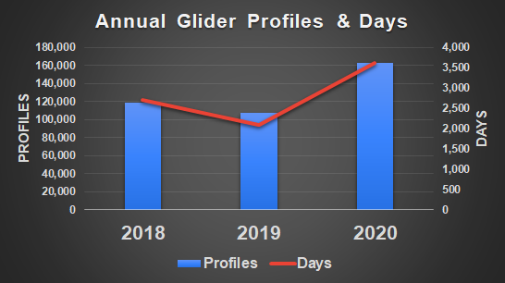
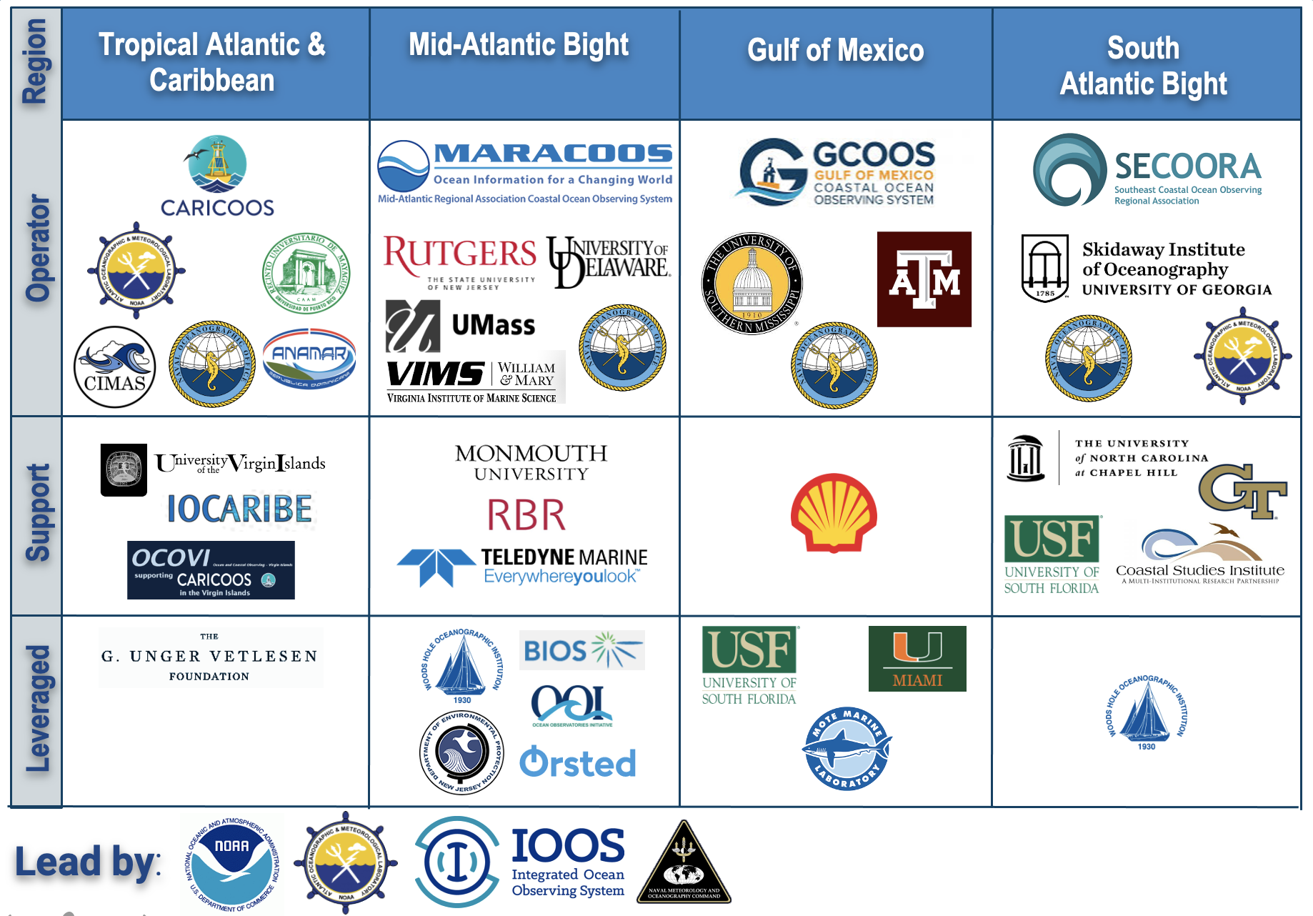
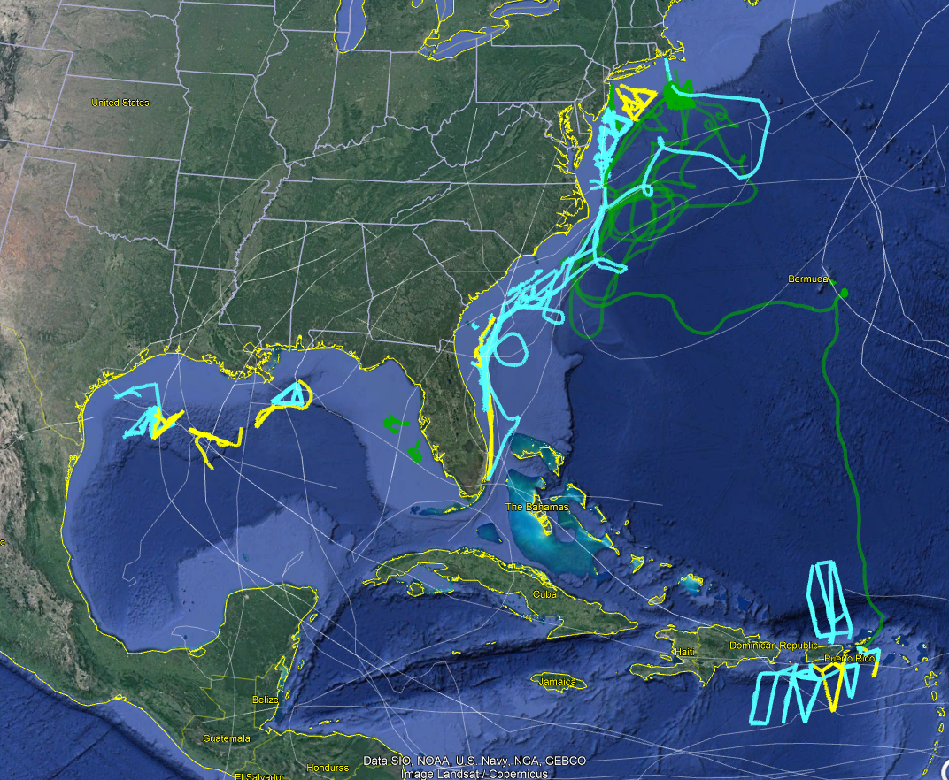
Hurricane Gliders - Current Capabilities
2020 Hurricane Season
56 Gliders on 79 Deployments
3,343 Glider Days
163,022 GTS Profiles
>50% increase over 2019
1) Distributed/diverse hurricane glider community
2) Numerous leveraged gliders & gliderports for sustained operations across 3 hurricane seasons
3) Data Flow > IOOS Glider DAC > NDBC > GTS
4) Hurricane Blog for science collaborations
Glider Data
in 15 Storms
NOAA/Partner
NAVY
Other Mission Glider*
Storm Track

Slide 4
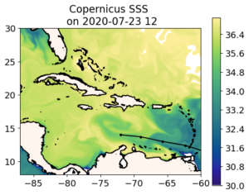
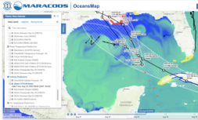
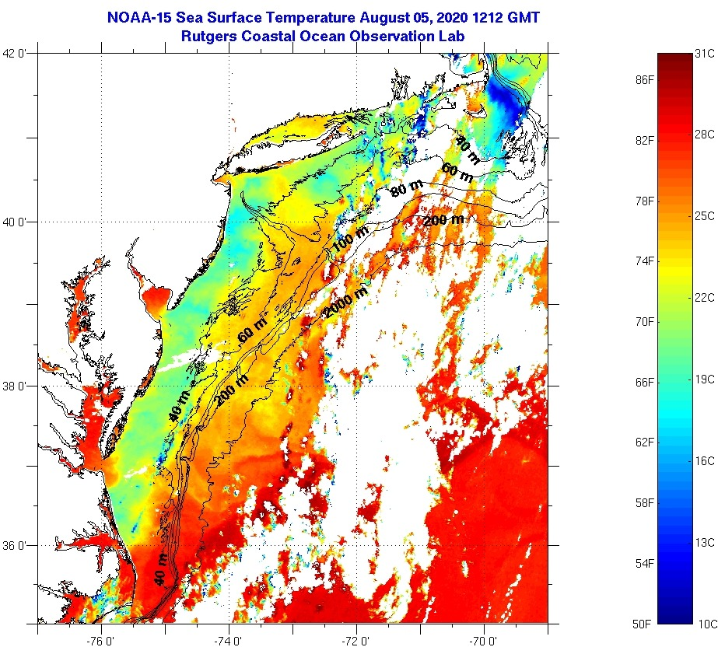
Multi-platform - Near-term possibilities
1. Caribe Corredores: Windward Island passage throughflows, mesoscale eddies & Amazon/Orinoco River barrier layers – climate, rapid intensification.
2. Gulf of Mexico: Loop Current, eddies, interacting with Mississippi River barrier layers - rapid intensification, heavy rain.
3. South Atlantic Bight: Gulf Stream meanders interacting with shelf waters – rapid intensity change, rain.
4. Mid Atlantic Bight: 3 classes of rapid co-evolution (Isaias, Irene, Sandy) - rapid weakening.
1.Caribe
3.SAB
2.GoM
4.MAB

Slide 5
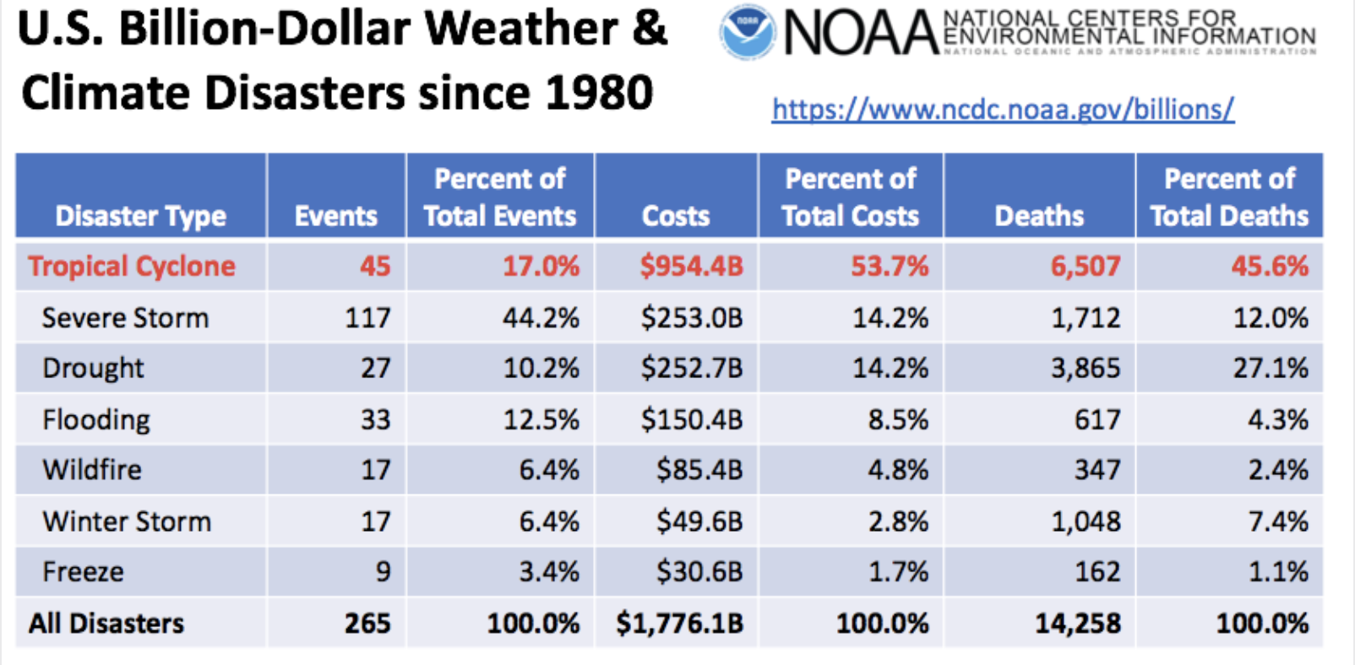
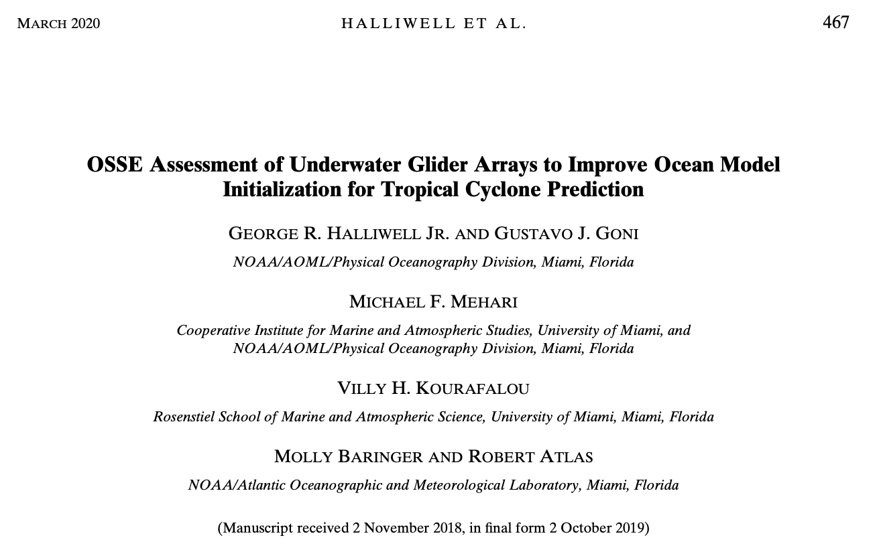
Hurricane Glider - Challenges and Gaps
Unified forecast strategy requires observations, models & data assimilation. Improved forecasting & understanding are connected.
Disaster Supplementals morphed into annual increments for hurricane glider operations, no science or education, and end in September 2021.
Leveraged assets aging. Funding cycles out of phase with hurricanes.
Ocean models and data assimilation have a new 2021 operational workflow. More multi-platform OSEs and OSSEs needed to optimize pre-storm conditions.
Community-based science storm simulation studies require broader access to models, an expanded data archive, and the data assimilation increments.
Additional opportunities to interact with a critical customer – the NHC forecasters.

Slide 6
Questions?

Slide 7
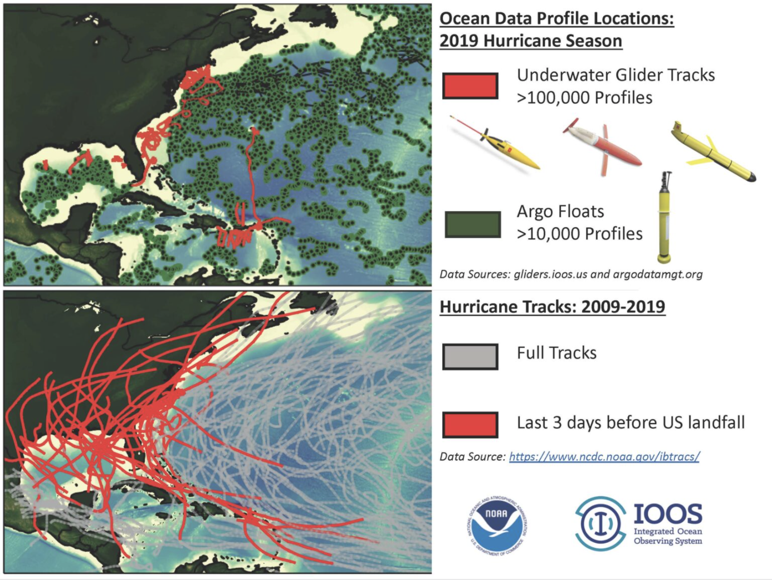
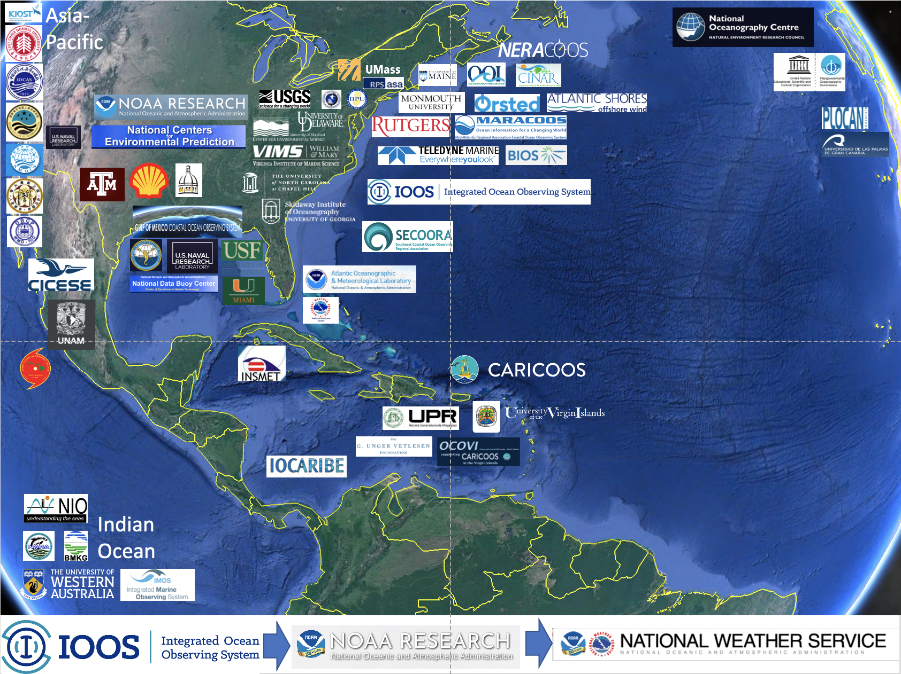
Hurricane Gliders – Supplementary Slide
Concept of Operations (ConOps): Argo+Gliders
Expanding Research & Operations Partnerships

Slide 8
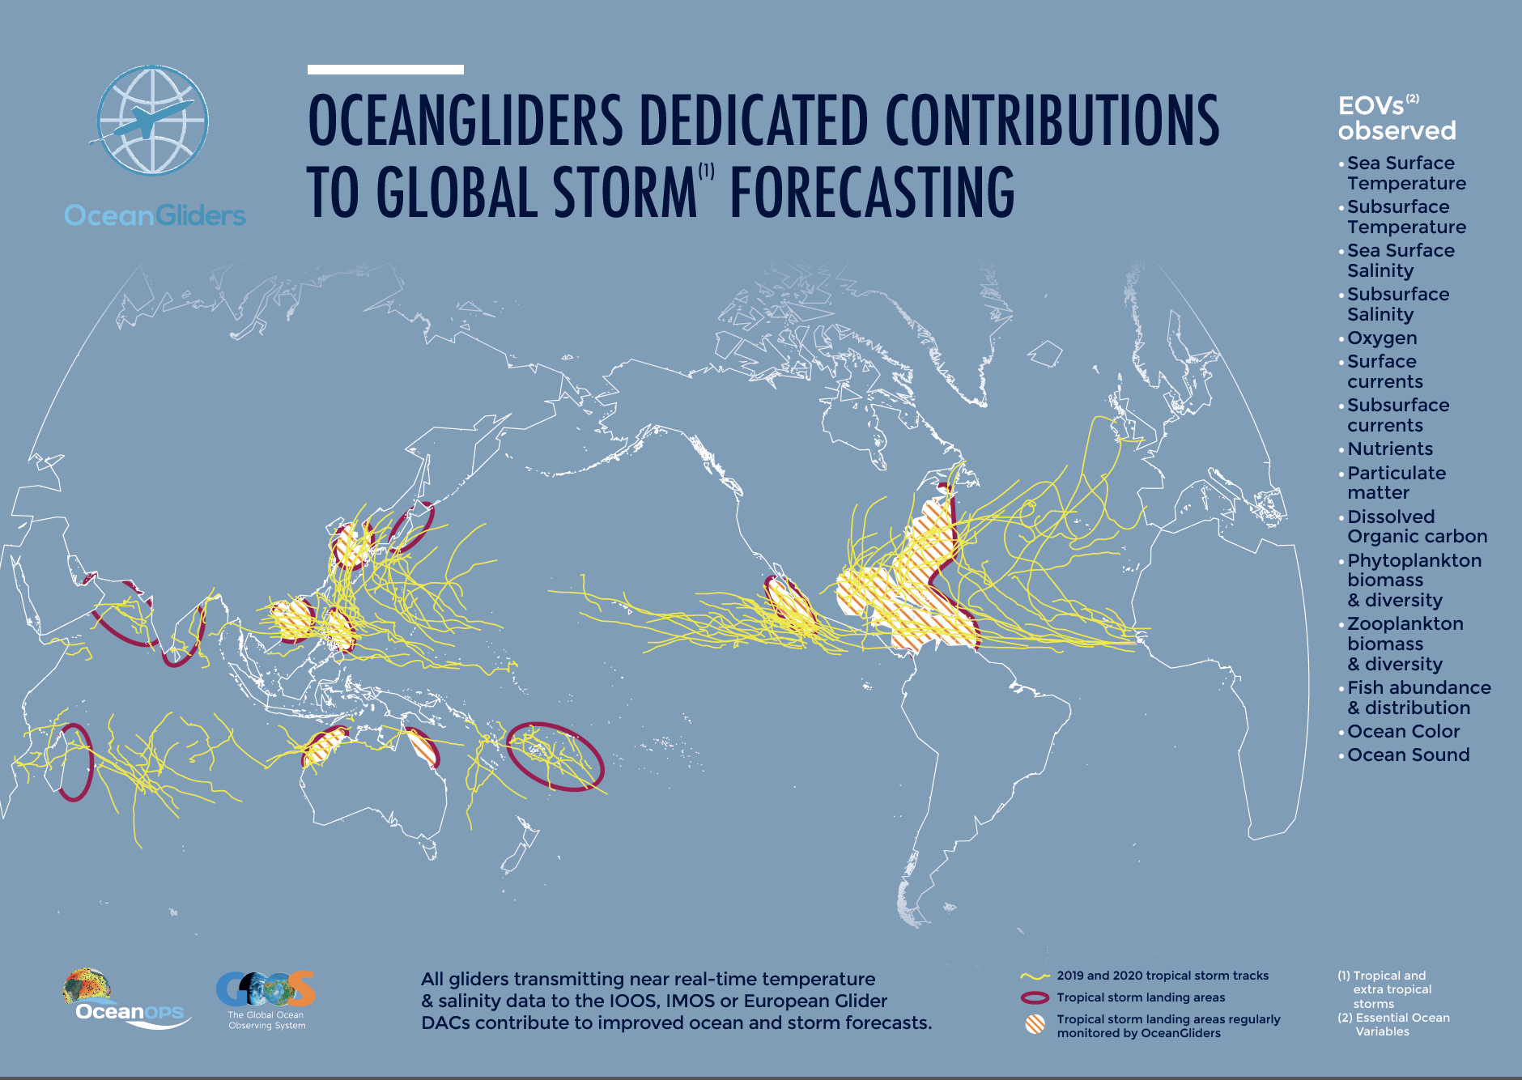
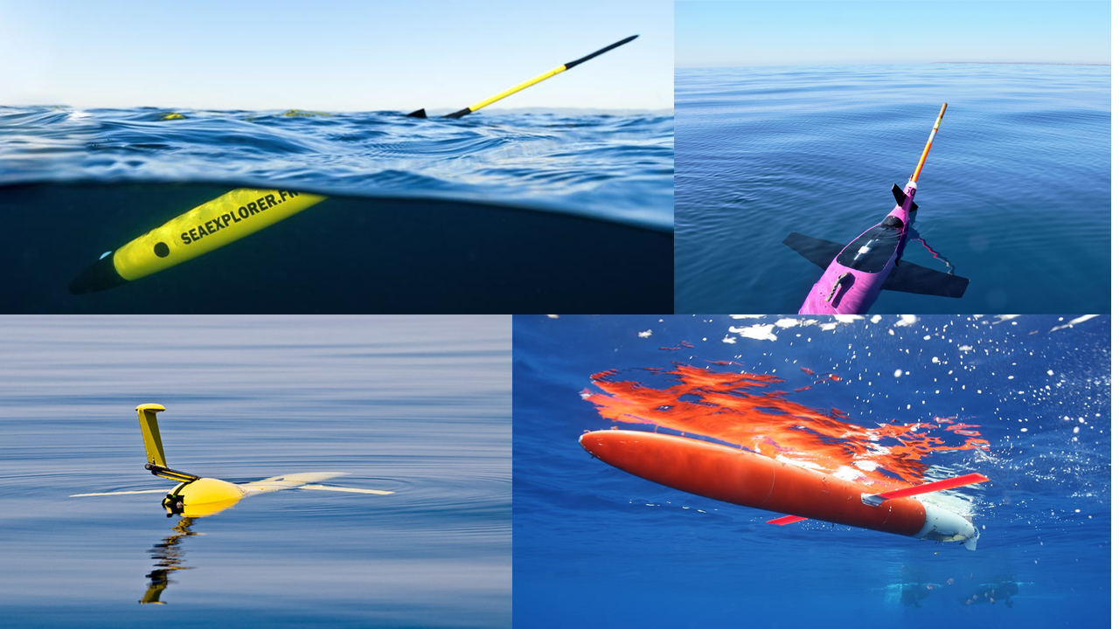
Global OceanGliders – Supplementary Slide
OceanOPS OceanGliders
https://www.oceangliders.org/
Storm Working Group
https://www.oceangliders.org/taskteams/taskteam1/

Slide 9
Additional Resources/Links
Rutgers Hurricane Research https://rucool.marine.rutgers.edu/research/hurricanes-and-cyclone-research/
IOOS Glider DAC https://gliders.ioos.us/map/
MARACOOS OceansMap https://oceansmap.maracoos.org/
GCOOS Gandalf https://gandalf.gcoos.org/
AOML Hurricane OceanViewer https://cwcgom.aoml.noaa.gov/cgom/OceanViewer/index_hrd.html
IOOS Model/Data Comparisons https://rucool.marine.rutgers.edu/research/hurricanes-and-cyclone-research/evaluation-of-operational-ocean-models/
Rutgers Hurricane Blog https://rucool.marine.rutgers.edu/blog/category/hurricanes/
Hurricane Glider Publications https://rucool.marine.rutgers.edu/research/hurricanes-and-cyclone-research/ https://www.aoml.noaa.gov/hurricane-glider-project/

